Slide 1
Chapter Eleven
Pricing Strategies

Slide 2
Pricing Strategies
Topic Outline
New-Product Pricing Strategies
Product Mix Pricing Strategies
Price Adjustment Strategies
Price Changes

Slide 3
New-Product Pricing Strategies
Pricing Strategies
Market-skimming pricing
Market-penetration pricing

Slide 4
New-Product Pricing Strategies
Market-skimming pricing is a strategy with high initial prices to “skim” revenue layers from the market
Product quality and image must support the price
Buyers must want the product at the price
Costs of producing the product in small volume should not cancel the advantage of higher prices
Competitors should not be able to enter the market easily

Slide 5
New-Product Pricing Strategies
Pricing Strategies
Market-penetration pricing sets a low initial price in order to penetrate the market quickly and deeply to attract a large number of buyers quickly to gain market share
Price sensitive market
Inverse relationship of production and distribution cost to sales growth
Low prices must keep competition out of the market

Slide 6

Product Mix Pricing Strategies
Product Line Pricing
Setting Price Steps Between Product Line Items
i.e. $299, $399
Optional-Product Pricing
Pricing Optional or Accessory Products
Sold With The Main Product
i.e. Car Options
Captive-Product Pricing
Pricing Products That Must Be Used
With The Main Product
i.e. Razor Blades, Film, Software
By-Product Pricing
Pricing Low-Value By-Products To Get Rid
of Them
i.e. Textile made ups
Product
Mix
Pricing
Strategies
Product-Bundle Pricing
Pricing Bundles Of Products Sold Together
i.e. Fast food
Notes:
Product-Mix Pricing Strategies
This CTR corresponds to Table 11-1 on p. 331 and the relates to the material on pp. 331-334.
Product-Mix Pricing Strategies
Product Line Pricing. Companies usually develop product lines rather than single products. In product line pricing, management must decide on the price steps to set between each product in the line. Companies often use price points to target distinctive combinations of product features and value represented by a particular price.
Optional-Product Pricing. Under this strategy, the company offers a base product and prices differently for each combination of additional features or options added to the base product as desired by the customer. Automobile pricing is famous -- or infamous -- for this practice. But many manufacturers use optional-product pricing, such as personal computer makers.
Captive-Product Pricing. Under this strategy, producers price products that must be used with a main product. The text describes razor blades as an example. The razor is priced low while high markups are attached to the price of the blades.
Discussion Note: Students should distinguish captive pricing from optional pricing on the basis of need versus convenience. When Apple Computer prices its keyboards separately from its computers, it is practicing captive-product pricing. When it offers additional RAM beyond the included board memory, it is practicing optional-product pricing.
By-Product Pricing. Waste from production and distribution may be marketable as by-products. Selling by-products allows producers to lower prices and costs on their main products. Otherwise, the prices of main products must cover the disposable or storage of by- products.
Product-Bundle Pricing. This strategy combines several products and offers them at a reduced price from the cost of each product purchased separately. Season tickets and group rates are examples.
Sims and balance

Slide 7
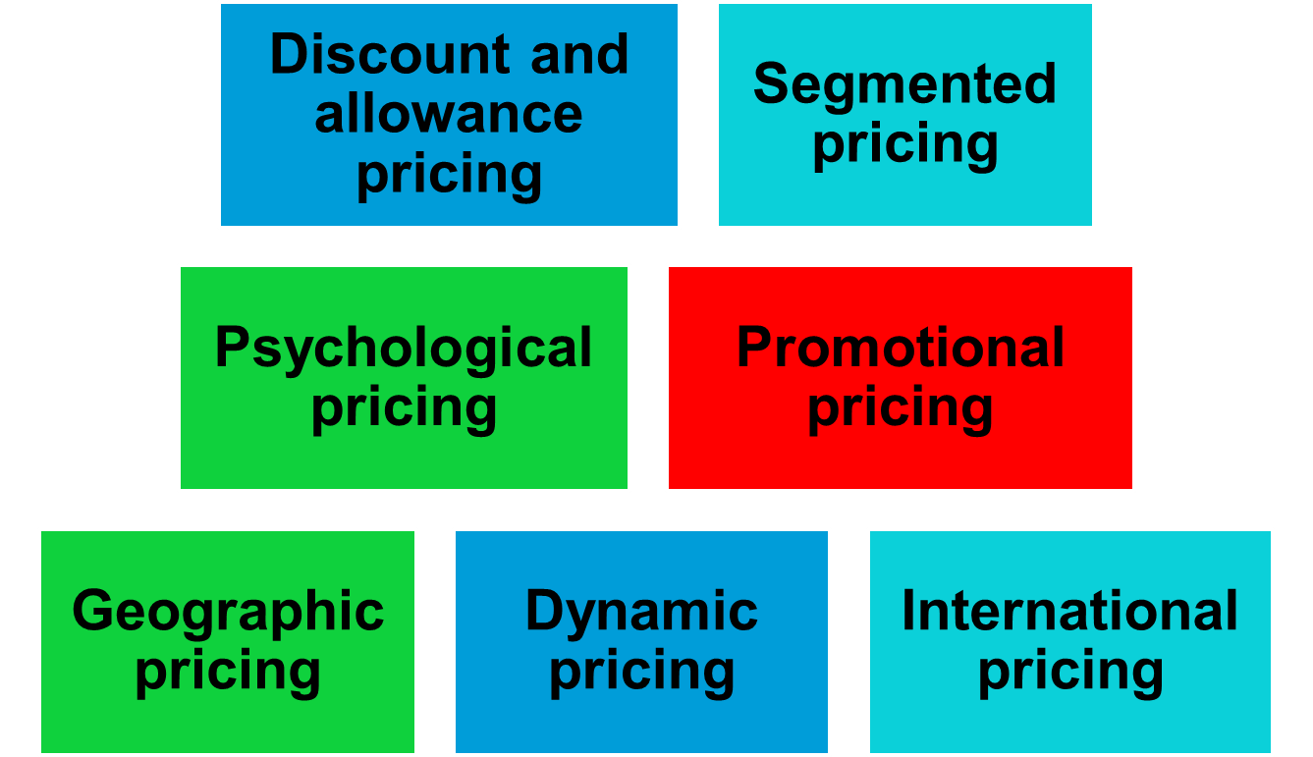
Price-Adjustment Strategies

Slide 8
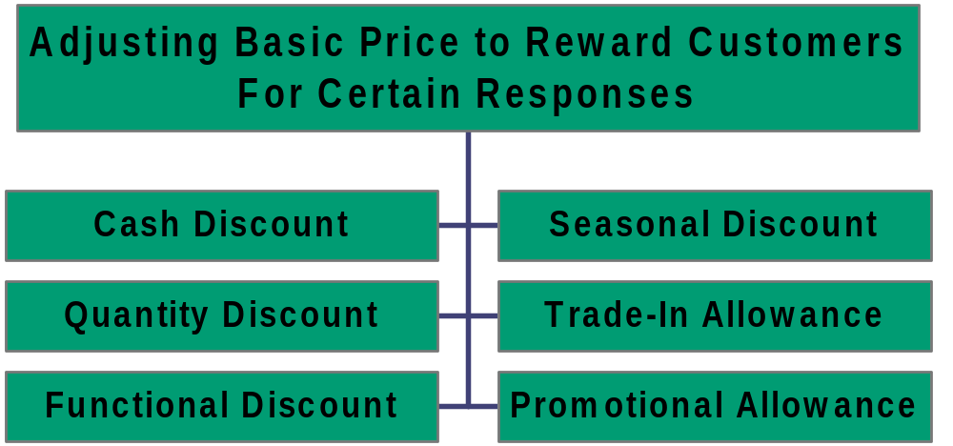
Discount and Allowance Pricing

Slide 9
Discounts
Quantity
Discount
Pricing
Quantity discounts reward bigger buyers

Slide 10
Quantity
Seasonal
Discount
Pricing
Seasonal discounts encourage purchases earlier than demand

Slide 11
Quantity
Seasonal
Discount
Pricing
Cash
Cash discounts encourage customers to pay invoices earlier

Slide 12
Quantity
Seasonal
Discount
Pricing
Cash
Trade discounts reflect jobs done by middlemen … and usually are pretty much standardized by expected margins
Trade/ Functional

Slide 13
Quantity
Seasonal
Discount
Pricing
Sale/Promotion
Cash
Trade/ Functional
Trade
Temporary price cuts
to shift demand

Slide 14
Allowances
Advertising
Allowance
Common
Kinds of
Allowances
Advertising or promotion allowance is a reduction from amount due to compensate middleman for promotion expenses, often as a percentage of total sales

Slide 15
Advertising
Allowance
Stocking
Allowance
Common
Kinds of
Allowances
Stocking allowances (also known as slotting fees) are payments to wholesalers or retailers to stock unproven new products (I.e., “rent” for shelf space)

Slide 16
Advertising
Allowance
Stocking
Allowance
Common
Kinds of
Allowances
Trade-in allowances are relatively uncommon but in some business markets are critical
Brokers often develop to get rid of used products
Trade-In
Allowance

Slide 17
Advertising
Allowance
Stocking
Allowance
Common
Kinds of
Allowances
Push Money
Allowance
Trade-In
Allowance
Push money is an allowance that is usually passed on to salespeople for pushing a particular product

Slide 18
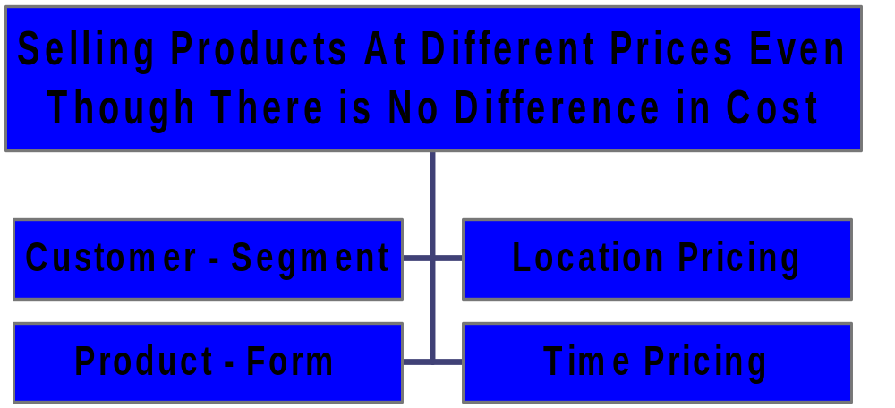
Segmented Pricing

Slide 19
Segmented Pricing
Customer – segment:
students, teachers, senior citizen
Product Form:
Quantity, Packaging
Time pricing:
Month, Day, Evening, Resorts charge higher on weekends, Airline tickets
Location:
Cinemas, Sea view rooms, Distance learning

Slide 20

Psychological Pricing
Considers the psychology of prices and not simply the economics.
Customers use price less when they can judge quality of a product.
Price becomes an important quality signal when customers can’t judge quality; price is used to say something about a product.
Value $22.00
Sale $14.99

Slide 21
Odd/Even Pricing--Does It have an Impact?
Theory: $3.00 is rounded to $3.00 while $2.99 is rounded to “$2.00 plus change”
Reality: Studies in U.S. have found some impact; no impact found in Germany
Note that odd pricing may signal receiving a bargain, which may or may not be compatible with the desired product image
Sale $14.99

Slide 22
Promotional Pricing

Slide 23
Special-Event Pricing
Temporarily Pricing Products Below List Price to Increase Short-Term Sales Through
Cash Rebates
Low-Interest Financing
Longer Warranties
Free Maintenance

Slide 24
Geographical Pricing
F.O.B.
Common
Geographic
Pricing
Policies
F.O.B. means “free on board” (e.g., at some place such as a factory, warehouse, destination,etc.)
  Customer pay the freight and take risk of shipping product

Slide 25
F.O.B.
Zone
Common
Geographic
Pricing
Policies
Zone pricing sets some “average” price that is used anywhere within a specific geographic zone (I.e., may be a whole country or region), but prices differ between zones

Slide 26
F.O.B.
Zone
Common
Geographic
Pricing
Policies
Uniform
Delivered
Making an average freight charge to all customers, usually used when transportation costs are low or for simplicity.

Slide 27
F.O.B.
Zone
Common
Geographic
Pricing
Policies
Uniform
Delivered
Freight
Absorption
Seller absorbs all or part of the freight costs to meet the prices of the nearest competitor … amounts to price cutting to appeal to distant customers.

Slide 28
Basing-point pricing
A geographical pricing strategy in which the seller designate some city as a basing point and charges all customers the freight cost from that city to the customers.

Slide 29
FOB Origin
Pricing
Tactics
Based on
Geography
Uniform Delivered
Zone Pricing
Freight-Absorption
Basing-Point

Slide 30
Initiating and Responding to Price
Changes
Competitor
Reactions
to
Price
Changes
Initiating
Price Cuts
Price Changes
Buyer
Reactions
to
Price
Changes
Initiating
Price
Increases
Notes:
Price Changes
This CTR relates to the material on pp. 340-342.
Initiating Price Changes
Price changes may be initiated for several reasons, including:
Price Cuts. Reasons for cutting prices may stem from overcapacity, falling market share, or attempts to dominate the market through lower costs.
Price Increases. Inflation is a major source of price increases but so is the tendency to speculate on inflationary trends and raise prices beyond the rate of inflation. Over demand may also cause prices to rise. Higher prices can also increase profit margins.
Buyer Reactions to Price Changes. Buyer reactions usually respond directly to price changes but not always. Usually lower prices pleases consumers, higher prices do not. But sometimes higher prices support quality improvements and lower prices mean company or product problems. Whether the buyer is correct or not in these perceptions will not immediately change their inclination to act on them.
Competitor Reactions to Price Changes. Competitors most often react in industries with a small number of firms, uniform products in the market, and buyers are well informed. Competitive reactions may be similar price changes or increased non price competition. Companies should anticipate probable competitive moves prior to initiating price changes.

Slide 31
Initiating Price Cuts is Desirable When a Firm:
  Has excess capacity
  Faces falling market share due to price competition
  Desires to be a market share leader

Slide 32
Price Increases are Desirable:
  If a firm can increase profit, faces cost inflation, or faces greater demand than can be supplied.
Alternatives to Increasing Price
  Reducing product size, using less expensive materials, unbundling the product.

Slide 33
Buyer reactions to price changes must be considered. (Price increase and price cuts)
Competitors are more likely to react to price changes under certain conditions.
  Product is uniform
  Buyers are well informed

Slide 34




Has Competitor Cut
Price?
Price-Adjustment Strategies
Hold Current Price;
Continue to Monitor
Competitor’s Price.
No
Will Lower Price
Negatively Affect Our
Market Share & Profits?
Yes
Raise Perceived
Quality
No
Can/ Should Effective
Action be Taken?
Improve Quality
& Increase Price
Yes
Launch Low-Price
“Fighting Brand”
No
Yes
Reduce Price

Slide 35
Price-Adjustment Strategies
Pricing Strategies
International pricing is when prices are set in a specific country based on country-specific factors
Economic conditions
Competitive conditions
Laws and regulations
Infrastructure
Company marketing objective

